Slide 1



Adoption & Foster Care
Seminar
.
Sponsored by Baylor University, Human Resources

Slide 2
Baylor University Adoption Assistance Program
What does it offer?
Up to $10,000 (previously $6,000) in reimbursement of Qualified Adoption Expenses that are paid or incurred in connection with the final adoption of an Eligible Child and while an Eligible Employee under the Program.
Who is eligible?
Once 12 continuous months of full-time employment with Baylor has been completed, any Full-time faculty members and post-doctoral fellows who have been appointed at .75 full-time equivalency or more per semester; and full-time regular staff members who are scheduled to work 30 or more hours per week are eligible.
How do I find out more about this program?
Please visit www.baylor.edu/hr/benefits or contact us at 254-710-2000 or askHR@baylor.edu

Slide 3
Baylor University Paid Parental Leave
What does it offer?
Effective January 1, 2020 – Paid Parental Leave increased to up to 6 weeks (240 hours) of paid leave for birth, adoption and foster care!
Who is eligible?
All full time employees who are in a benefits-eligible staff position. Eligibility is immediate upon employment with Baylor University.
How do I find out more about this program?
Please visit www.baylor.edu/hr/benefits or contact us at 254-710-2000 or askHR@baylor.edu

Slide 4
Nightlight Christian Adoptions Domestic, International, Embryo Adoptions www.nightlight.org (254) 741-1633 Lindsay Belus, LMSW lindsay.belus@nightlight.org

Slide 5

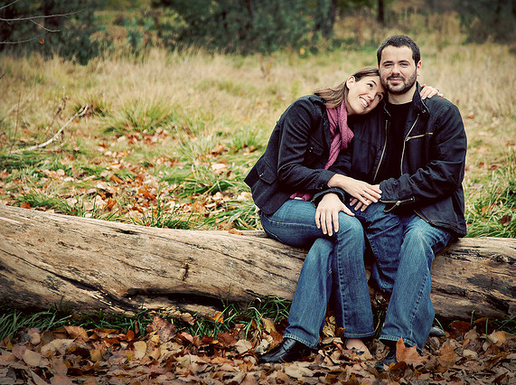
Overview
Established in 1959; Now operating licensed offices in 10 states.
Placed over 4,000 children into loving families in the past 20 years.
Domestic Infant Adoption
International Adoption
Snowflakes® Embryo Adoption
What type of adoption is right for you?

Slide 6
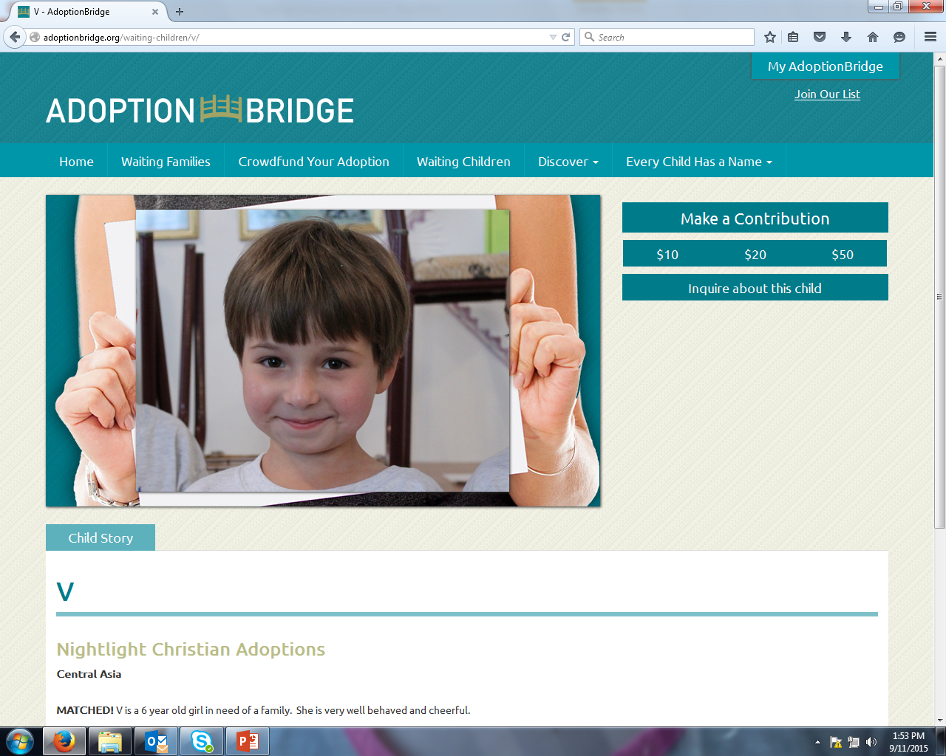
We have children waiting…
Visit today:
AdoptionBridge.org
A child on Adoption Bridge is waiting for their forever family.
100s of child profiles demonstrate the need for adopting families like yours.

Slide 7
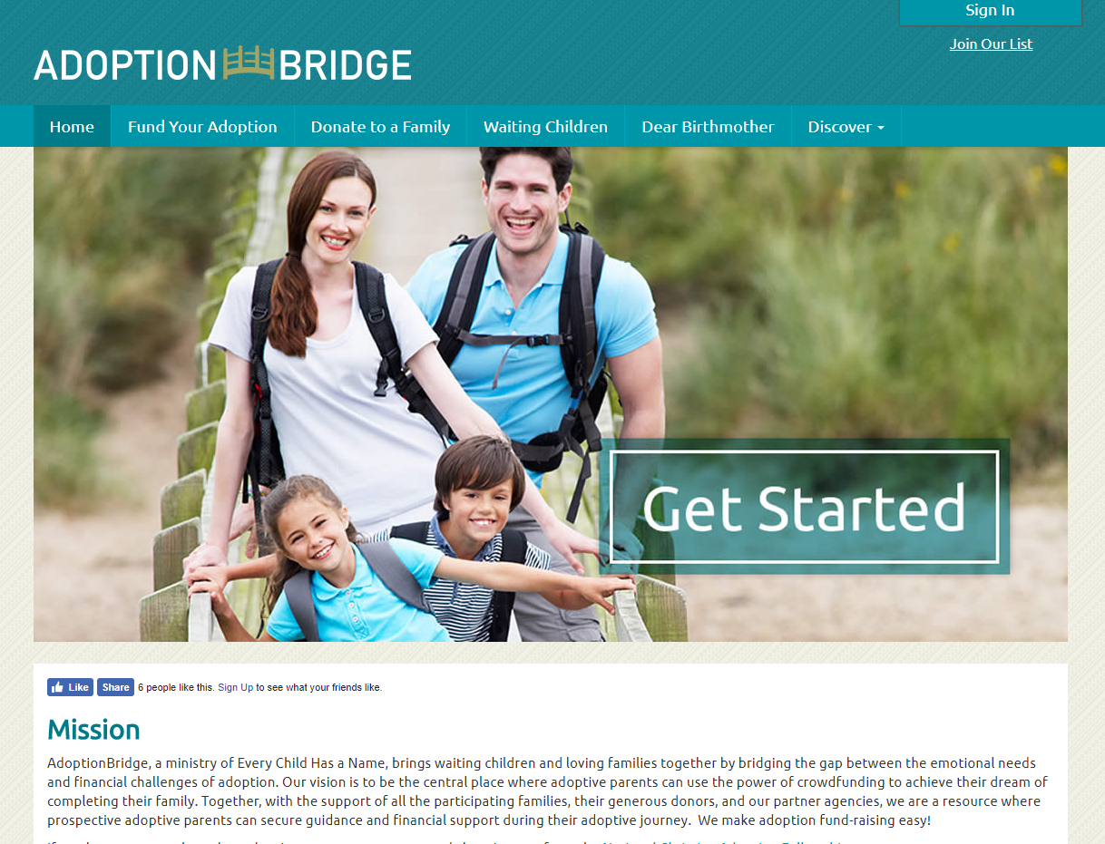
Funding your adoption is very possible. Don’t let money be your obstacle!
AdoptionBridge.org
Crowdfunding
Adoption Loans: Abba Fund/ACCU
Adoption Grants: Show Hope
IRS $13,100 Tax Credit

Slide 8

More Than an Adventure, A Lifelong Journey
International Adoption

Slide 9




Why do people
adopt internationally?
Heart of Compassion
Waiting Children
Shorter wait time for referrals
Certainty of Custody
Children of Many Ethnicities
Children of Various Ages
Sibling Groups of Children

Slide 10
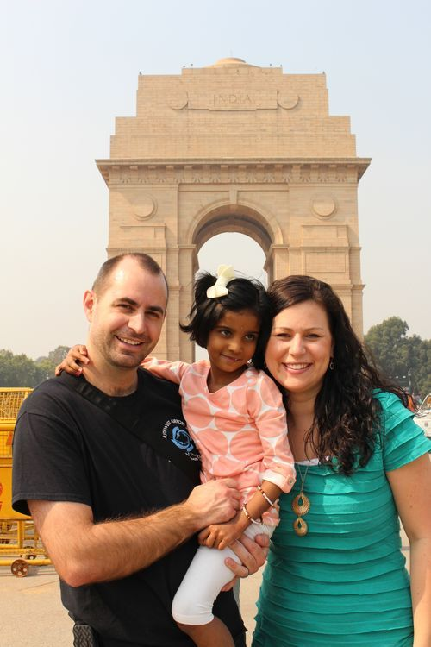
Considering a Country
Your specific interest
Age of children desired
Restrictions on adopting parents (age, marital status)
Overall cost of country program
Time to receive a referral
Travel (How often? How long?)
Other: country specific restrictions (e.g., current children in home, health of family members)

Slide 11

Special Option: Hosting a Child
Hosting programs are scheduled each year with children from various nations.
Often available in summer or Christmas vacation time frames.
Enjoy 2-3 weeks with a child, in your home, loving them and demonstrating ‘family life’.

Slide 12



















Nightlight Offers Many Programs
Visit www.Nightlight.org for our International Program Overview Tool
Albania
Bulgaria
China
Special Needs
Columbia
Ghana
Haiti
Hong Kong
Special Needs
India
Kyrgyzstan
Latvia
Nicaragua
Nigeria
Panama
Romania
Taiwan
Uganda
Ukraine
United
Kingdom

Slide 13

Process Overview
Select Country
Complete Required Documentation
Country Referral of Child
Travel Schedule Determined
Finalization
- Immigration
- Guardianship
- Re-adopt
Post Adoption Reports

Slide 14

Already in Your Heart
Domestic Adoption

Slide 15

What is Domestic Adoption?
An adoption plan for birth parents faced with an unplanned pregnancy.
It is a choice made by the birth parents – most often the birth mother.
It is irrevocable once an adoption is finalized.

Slide 16

Deciding if You Are Right for Domestic Adoption
Are you open to a relationship with the birth parents?
Do you desire to adopt a newborn infant?
Do you understand that birth parents can change his/her mind(s)?
Do you understand that there are potential legal risks?

Slide 17

Understanding the Process
Available Children: The birth mother chooses the adoptive family.
Understanding the Cost: Financial assistance may be available including the IRS Adoption tax credit.
Understanding the Risks: The birth parents may have been abusing substances. They can change their mind.

Slide 18

Time for a Baby!
Nightlight contacts adopting families when their birth mom goes into labor.
The birth mother may request the adopting parents be at the hospital or even in the delivery room.
The birth mother may or may not wish to interact with the baby.
The adoptive family usually holds and feeds the baby.
Relinquishment documents are signed (most states) The timing and way in which relinquishments take place depends on state law.

Slide 19
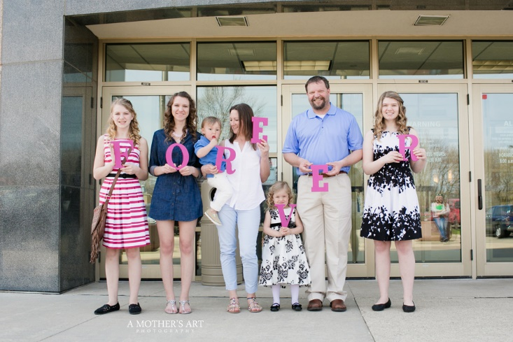
Home-going and Finalization
If the adoptive family resides in a different state than the baby's state of birth, they may have to remain in the state of birth for 7 or more days waiting for approval from state Social Services in each of the two states.
The adoption is finalized either in the adoptive family’s state or in the state where the baby was born.
In some instances, an attorney goes with the family to the court hearing.

Slide 20

Embryo Adoption
Adoption - Just 9 Months Earlier Than “Normal”

Slide 21




Did You Know…
n
You can give birth to your adopted child?

Slide 22

Over 1,000,000 Embryos in Storage
Embryos remain from couples who used in vitro fertilization who have completed their family. The Snowflakes® program has embryos available now.
Embryo adoption has been successful for many families who did not have success using IVF, or were diagnosed with infertility.
Embryo adoption provides fast-track for infant adoption.

Slide 23

Advantages
Control Of Pre-Natal Environment
Pre-Natal Bonding
Ability To Nurse The Child
Security of Placement
Affordable

Slide 24

The Snowflakes Process
Application Phase 1
Fertility Clinic Approval
Contract Phase 3
Shipping
Phase 4
Frozen Embryo Transfer
Welcome Home Baby!
Application & Agreement
Family Profile
Welcome Home Baby!
Matching Phase 2
Home Study
Physician Review

Slide 25
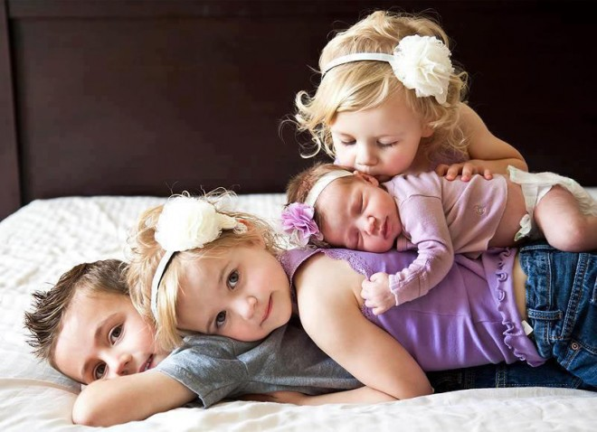
Multiple full-genetic siblings are possible

Slide 26

So which adoption process
.
is right for your family?

Slide 27

Do you desire less risk in the adoption process, and want more certainty about the outcome?
Is your heart pulled toward helping give an orphan a home?
Are you willing to consider a waiting child or a child with a medical need?
International Adoption

Slide 28
Are you not able or have no desire to be pregnant?
Are you tired of infertility treatments?
Are you hoping to adopt a newborn?
Is your heart pulled toward helping a woman in a crisis situation?
Domestic Adoption

Slide 29
Are you unable to conceive but able to carry a child?
Are you just not able to give up on your hope to be pregnant?
Is your heart pulled toward the idea of giving the chance of life to an embryo that is frozen?
Embryo Adoption

Slide 30
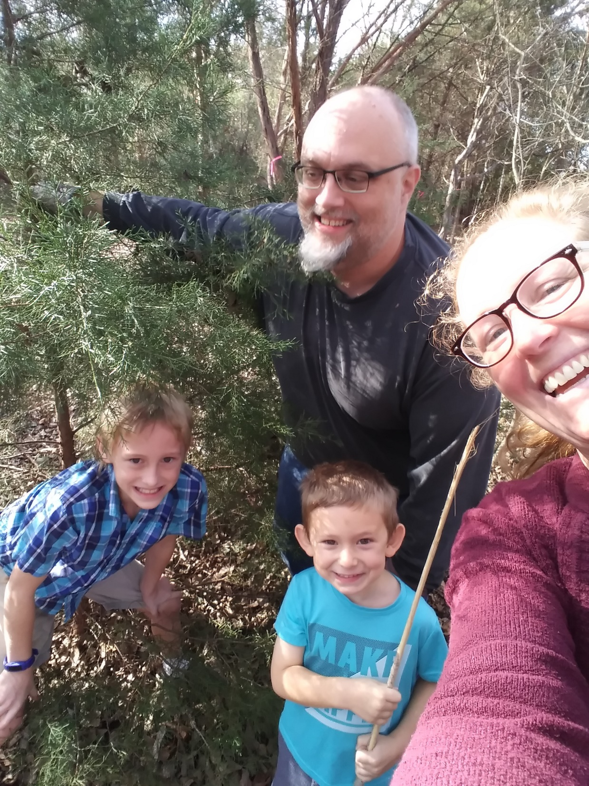
Pete and Rachael – Embryo Adoption Story

Slide 31

Presented by:
Emily Mosher, LCSW – Family Home Developer
Hope Middlebrook – Recruitment & Retention Coordinator

Slide 32



Who is Arrow Child and Family Ministries?
Arrow was founded in 1992 by a former child in foster care who grew up in a loving, Christian foster home.
Mission: Helping Kids, Strengthening Families
“Children are a gift of the Lord...like arrows
in the hand of a warrior.” Psalm 127:4

Slide 33
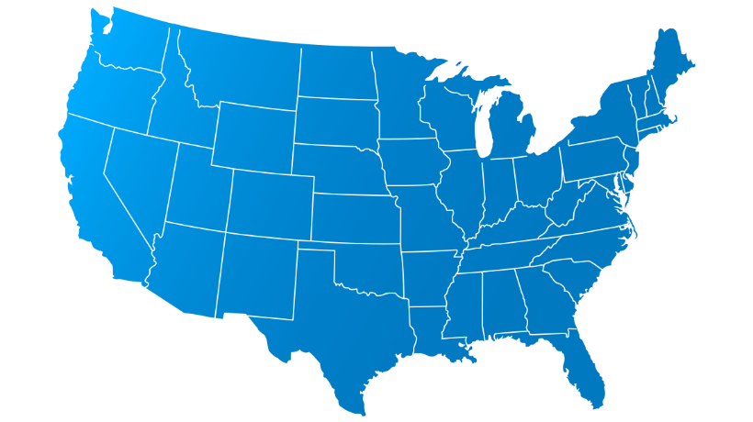










Youth Currently in Foster Care
14-17 YRS
21.6%
0-2
YRS
424,000
26.6%
Ages of
Youth in
Texas Foster
Care
10-13
YRS
17%
3-5
YRS
16,016
17.6%
6-9 YRS
IN TEXAS
17.2%
190 Children in CWOP
Numbers from DFPS,
as of March 2021
https://www.dfps.state.tx.us/About_DFPS/Monthly_Data/default.asp

Slide 34

Youth Currently Waiting for Adoption
A Youth Waiting for Adoption May Have these Characteristics:
Over the age of 6 years
Be a part of a sibling group
Have a medical condition(s)
Have physical, mental, or emotional disabilities
0-2
YRS
14-17 YRS
14%
28%
3-5
YRS
Ages of Youth
in Texas Waiting
for Adoption
13%
10-13
YRS
6-9 YRS
19%
6,806
25%
IN TEXAS
Numbers from DFPS,
as of August 2020
https://www.dfps.state.tx.us/About_DFPS/Data_Book/Child_Protective_Services/Adoption/Children_Waiting_Adoption.asp

Slide 35

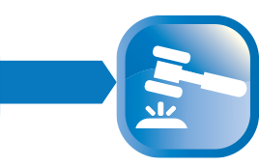







A Child's Journey Through CPS
A Child in Foster Care’s Journey
Youth Maltreatment
Is Reported
Child Protective
Services (CPS)
Investigates
Judge Decides If
Youth Should Be
Removed
Youth Placed with
Kinship or
Foster Family
The Bio Family’s Opportunity
Case Plan Developed
To Reunify The Family
Judge Periodically
Reviews Parental Progress
If Judge Decides NOT to
Reunify Family, Parental
Rights are Terminated
Youth Remains in
Foster Care, but is
Available for Adoption
If Not Adopted,
the Youth will be
Emancipated at 18
with No Support

Slide 36

Arrow Programs
Foster-Only
Serves youth ages 0-17 temporarily until they are reunited or placed with kinship
Foster-to-Adopt
Serves youth ages 0-17. The youth are fostered with hope of adoption, but there is a chance of reunification or kinship.
Straight Adopt
Adoption of a youth in foster care whose parent’s rights are already terminated
Kinship
When youth in foster care are placed in the home of relatives or “fictive” kin
Special Populations
PMN

Slide 37
State Adoption Subsidy
If the child or children meet one of the following criteria by the time of adoption:
Is 6 years of age or older
Belongs to a sibling group
Is 2 years of age or older and belongs to a minority group
Has been diagnosed by a professional with a "lifelong handicapping condition"
they receive:
Medicaid
A monthly stipend
A one-time coverage of adoption-related expenses (including attorney fees)
College tuition to a state college, vocational, or technical school in Texas

Slide 38

Treatment Foster Care Program
What is Treatment Foster Care?
Population
Clinical Intervention
Youth 3-17 years old at risk of being placed in an institutional setting (RTC or psychiatric hospital), who experience emotional, behavioral, and/or mental health difficulties.
Time Limited
Youth receives frequent support by a therapist and a behavioral support specialist.
Location
Youth would be in your home for 6 months with a potential 6-month extension. Not intended for permanency.
All locations!

Slide 39

Becoming a Foster Parent
Training
Home Study
Application
Complete an application and all additional paperwork
Pre-Service #1-7
BCMT I & II
CPR/First Aid
Meds Class
Adoption Training
Additional online courses
An inspection of your home and an interview of everyone living in the household.
This will be completed last.

Slide 40
What is My Next Step?
Attend Pre-Service #1!
Amarillo/Lubbock: Trashauna.Oates@arrow.org
Beaumont: Lauren.Graham@arrow.org
Brownwood: Brienna.Williams@arrow.org
DFW/Arlington: Shadai.Brinchfield@arrow.org
Waco: Hope.Middlebrook@arrow.org
North Houston (Spring)/South Houston (Sugarland): Ruth.Barrera@arrow.org
Tyler: Kim.Eylar-Sanchez@arrow.org & Glynn.Lindsey@arrow.org
McAllen: Lizbeth.Garza@arrow.org
San Antonio/Austin: Zachary.McPeek@arrow.org

Slide 41
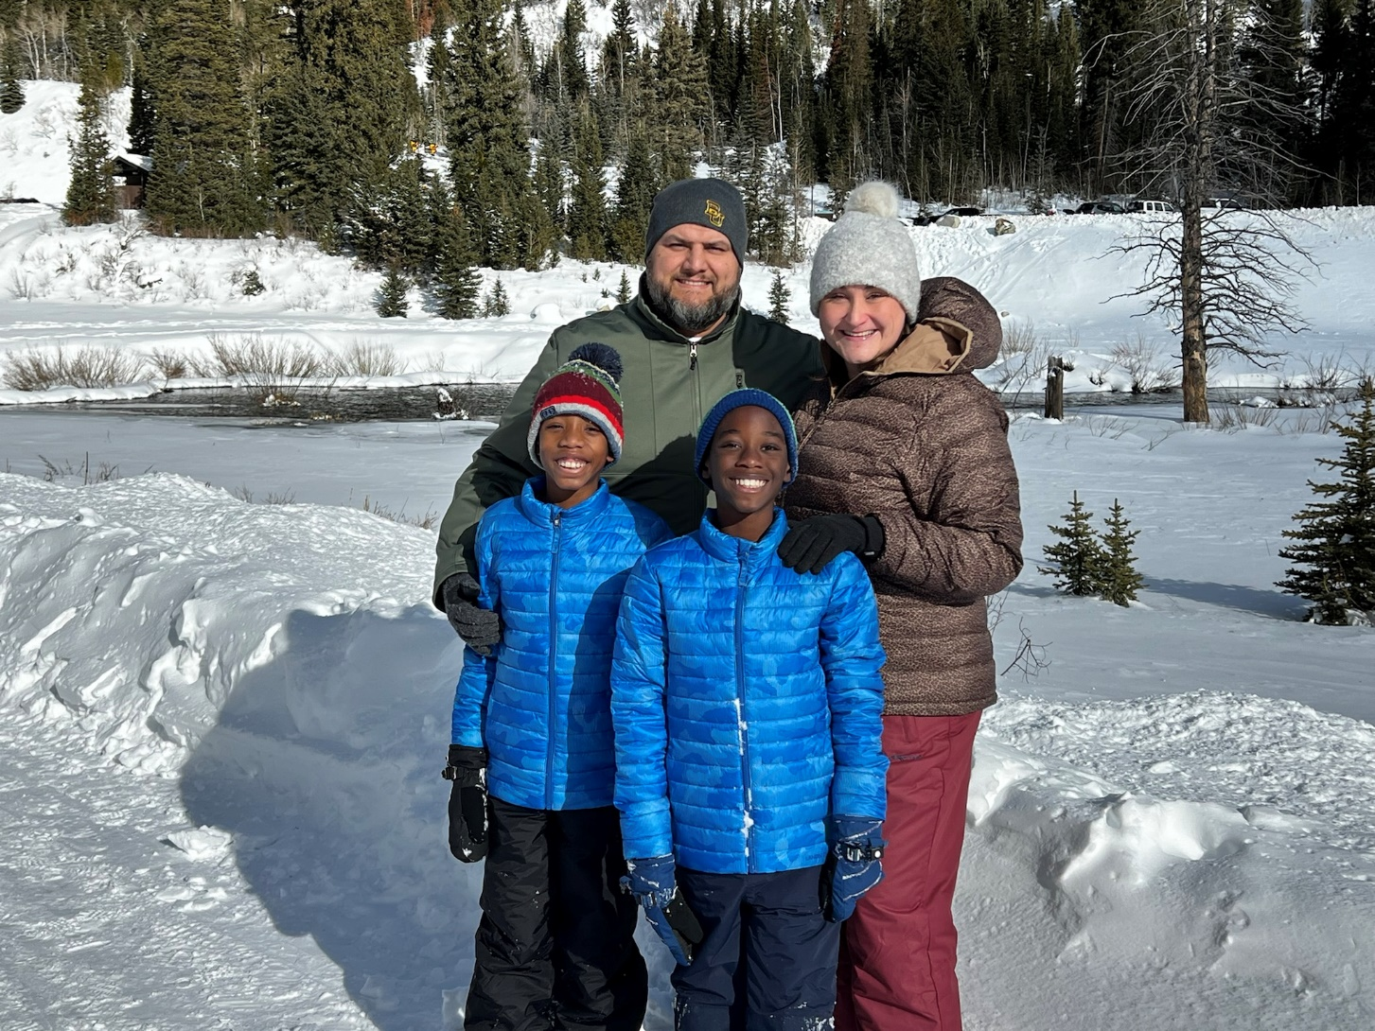
The Price Family – David, Nicci, Logan, & Ben

Slide 42
The Todd Family – James, Danielle, Madeline, & Lilly

Slide 43

Circles of Care Informational Presentation 2022 Jessica Wheeler-Macias: Case Manager
Circles of Care (COC) is a private agency dedicated to helping children, youth and families in need of social and mental health services. Circles of Care’s child placement program works with children taken into State custody due to abuse and neglect or other circumstances in which the children have been removed or lost their biological family. Circles of Care is not a State agency or a branch of the State, although we do receive most of our referrals from State departments, when they have the need for a home for a child/youth.
Website: https://www.circlesofcareinc.org/
Our Mission
is to enhance children, youth, and families’ ability for effective living and growth through comprehensive social and mental health services.

Slide 44
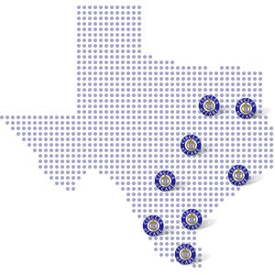
In 2000 Mrs. Edwards secured a contract with The Department of Family and Protective Services to provide services to children in conservatorship through a residential contract. Circles of Care began in Corpus Christi in Mrs. Edwards’ garage with only one other employee before moving to the location that it now calls its corporate headquarters.
In 2003, the decision was made to expand the agency and Mrs. Edwards turned her eye toward the other major cities in Texas. She wanted to share the success she experienced in Corpus Christi with children and families in other regions. The first satellite office was opened on November 1, 2003 in Salado, Texas, just north of Austin followed by a second in Houston less than a year later.
Still expanding in Region 11, an office in McAllen, Texas was opened just two months after reaching Houston.
In 2006 was also the year that Circles of Care acquired its adoption contract and was able to not only help children access comprehensive mental and social health services in a home environment, but also to help complete families.
In 2011, Mrs. Edwards began writing for the STAR contract to offer crisis intervention and counseling services to families in need. The agency was awarded the contract in 2012 and began offering comprehensive mental health services in Nueces, Kleberg, and Jim Wells County, free of charge, to the community with the goal of maintaining the continuity of families and averting and handling the crises that these families were experiencing.
In 2012 two more satellite offices for the Circles of Care residential childcare program were launched in Dallas, Texas and in Laredo, Texas.

Slide 45
Minimum Qualifications for Foster/Adoptive Parents
Age: All caregivers must be at least 21 if married or 25 if single
Background Check: All caregivers as well as household members 14 years and older are required to complete a background check that consists of:
Texas Criminal History check
National Criminal History check (FBI)
Central Registry check (Abuse and Neglect)
Out-of-State Abuse/Neglect History check (if resided out of the state of Texas in the last 5 years)
Out-of-State Criminal History check (if resided out of the state of Texas in the last 5 years)
Citizenship: All caregivers must be a United State Citizen or Permanent Resident
Education: All caregivers must have at minimum a GED or be able to pass an educational screening tool.
Transportation: Caregivers must have dependable transportation and the ability to transport children to all appointments and visitations.
Household Space: Caregivers can own or rent their home; however, must have adequate space for each child.

Slide 46
Misconceptions:
Fostering is a financial strain: Fostering a child is not a greater financial burden on a foster parent/family than caring for any other child in a family. In fact, foster parents receive monthly stipends to help cover costs of essential needs.
I have no experience, so I shouldn’t be a foster parent: Foster children need responsible, loving, trustworthy parents who are willing and able to pour love and care into them.
Foster parents can only be married couples: Circles of Care does not discriminate and provides opportunities to recruit foster parents who are single dads and mothers, as well as older couples/empty nesters. Outside of age requirements, background checks, and other assessments to ensure you have the space and resources to take care of a child, all perspective foster parents are considered and welcomed to apply.
Foster parents are stay-at home parents: The median age of foster youth is 7.8 years old, or school aged. Children spend much of their day at school and work well for families with working parents.

Slide 47
Expectations and Duties
Basic Care: Caregivers are required to provide at minimum the same care that one would for their own biological child to include:
Shelter
Food
Clothing
Diapers
School supplies
Recreation (sports, extra-curricular activities, etc.)
Supervision: Supervision is dependent on the child’s service level as well as the behaviors they may be exhibiting in the home. Caregivers are responsible for the well being of the children in the home and are expected to supervise any child accordingly.
Support: As a caregiver to a child in care, it is expected that encouragement, guidance, and assistance will be provided for each child.
Discipline: Per the state Minimum Standards and Circles of Care policy no child can be physically discipline nor can they be subjected to psychological punishment (i.e. threatening of current placement)

Slide 48
Transportation: Caregivers are responsible for any appointment under 60 miles, after 60 miles round trip Circles of Care will reimburse depending on cause. (examples: Court appointment, family/sibling visits, etc.) Medicaid Transportation reimburses for all medical appointments if they are contacted prior to the appointment.
Therapeutic Intervention: Caregivers are expected to participate in the child’s appointments and work with ALL the professionals assigned to each child. Caregivers are to follow the recommendations of ALL professionals.
Individual Therapy, Sibling Therapy, Family Therapy, Play Therapy, Etc.
Psychological Evaluations
CANS Assessments
Psychiatric Evaluation (Medication Management)
Paperwork: Caregivers are responsible for ensuring that the child’s legal team is aware of the day in and day out on-goings of the child in the home. Some of the main documentation that is required include:
FORM 2403- Medical/Dental/Vision/Hearing Examination Form
Medication Logs
Child Weekly Progress Notes (As needed)
Incident Reports

Slide 49
BASIC VS. THERAPEUTIC CARE

Slide 50
Determining Service Levels
Youth for Tomorrow Foundation (YFT) is a not-for-profit behavioral health care company in Texas providing quality assurance and utilization review management.
Youth For Tomorrow (YFT) determines service levels for children requiring more than basic services such as Moderate or Specialized.
If it is determined that a child requires more than basic services, specific documentation must be submitted to Youth For Tomorrow (YFT), for an assessment of the child’s service level needs. YFT is required to review the records of children who require more than basic services and determine whether the child requires a higher service level.

Slide 51



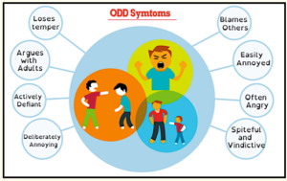



Examples of Behaviors Children Might Display
Physically Aggressive
Verbally aggressive
Oppositional Defiant Behavior
Hoarding Food
Withdrawn
Temper Tantrums
Bed Wetting

Slide 52
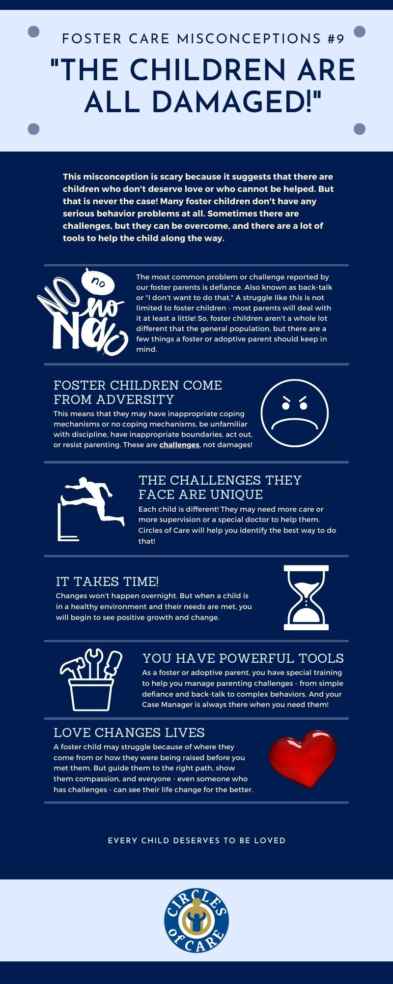
It’s incredible what a structured environment and support system can do for a child. Foster Parents have the ability to positively impact a child who has experienced trauma, teach them healthy coping skills, and help them grow into a thriving individual.

Slide 53
Carolyn Hughes

Slide 54
AVERAGE LENGTH OF STAY

Slide 55
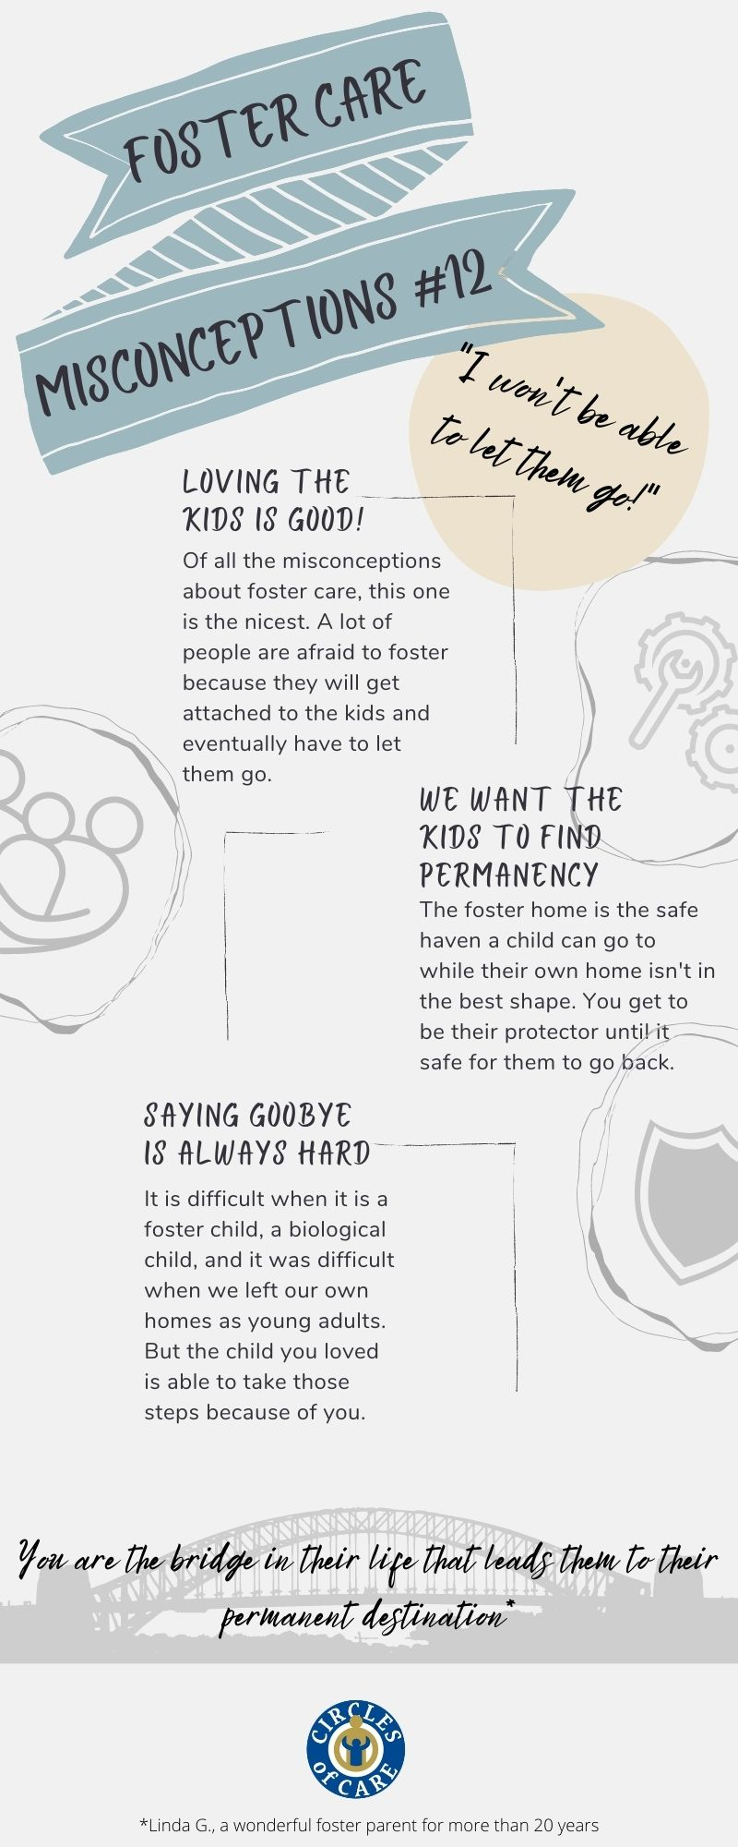
The time a child is in your home can vary for many reasons:
It is dependent on if the child's parental rights have been terminated or if the parents are working their required services.
If the parental rights are terminated, then the child is placed in the adoption unit. Relatives of the child are always contacted first and if they do not want to take on the responsibility then the foster parents are given the option of adopting.
Once the child is placed in the adoption unit, they can stay in foster care until they are adopted, or they turn 18 and emancipate from foster care.

Slide 56
REQUIREMENTS FOR LICENSURE

Slide 57
First Set of Paperwork
Individual Applications
These can be completed online at the Circles of Care website, or a paper copy can be turned in.
References
Each caregiver must supply four references on the application.
All biological children over the age of 12 that do not reside in the home must also complete a reference.
Background Check Consent Form
Each caregiver and any household member over the age of 14 will need to complete a consent form either online at the Circles of Care website or turn in a paper copy.
A copy of the Social Security Card and Drivers License/State ID will need to be turned in with the consent.
Second Set of Paperwork
Personal/Home Documentation
Proof of Education
Birth Certificates
Marriage License/Divorce Decree
Rabies Vaccinations for all pets
Home/Renters Insurance
Vehicle Insurance/Registration
Circles of Care Forms
Disaster and Emergency Form
Parenting Scale to be individually completed
Budget Form
General House Rules
Family Violence Acknowledgement
Weapons Inventory
Doctor/Dentist/Hospital Form
Right of Refusal Acknowledgement

Slide 58
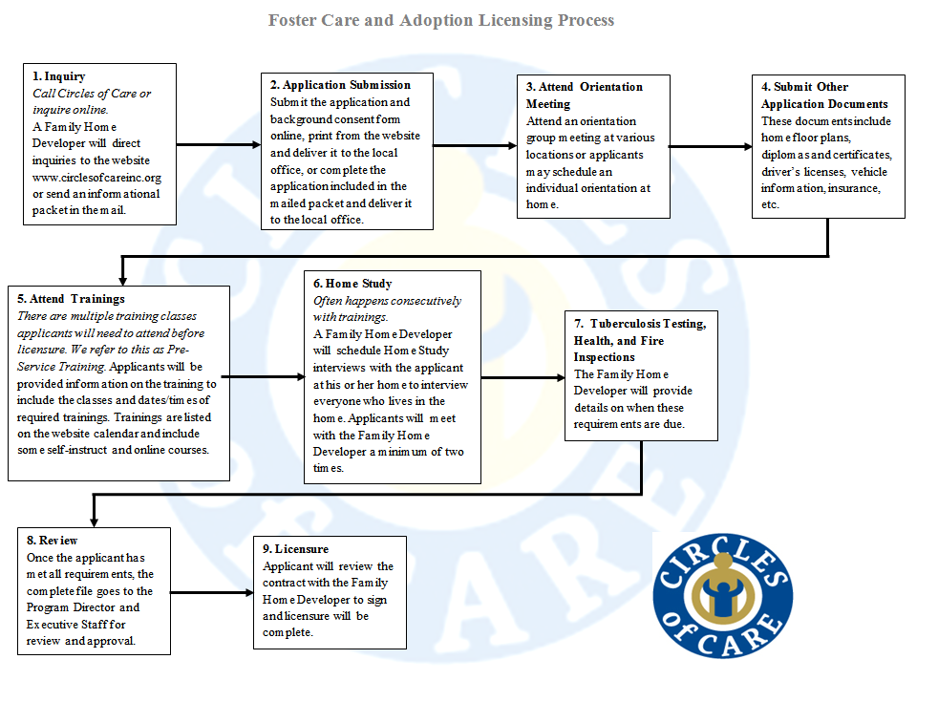

Slide 59

Home studies provide DFPS and the courts with the necessary comprehensive information for determining the most appropriate home for a child.
A home study is conducted after you have completed your training classes and application to adopt or foster.
Home study interviews can range from 3-6 hours and can be broken into various appointments.

Slide 60
RESOURCES AND SERVICES TO FOSTER PARENTS

Slide 61
Case Management Support
Case Managers are on call 24/7. They can be reached via cell phone during office hours and for after hour emergencies.
Circles of Care has a live web chat that is manned during business hours.
Reimbursement Rates
These are based on the needs of each child. The greater the level of a child, the higher the needs are to be met.
Level Basic - $27.07/day
Level Moderate - $47.37/day
Level Specialized - $58.00/day
Respite Reimbursement
This is an incentive Circles of Care offers for families to take a break from the children. At times it is difficult to find respite providers so we encourage you to find a friend that might want to be licensed as a respite provider.
Annual Training Fund
Circles of Care offers each caregiver $250.00 each year to obtain the required annual training hours. This is a reimbursement.
Inspection Reimbursement
Fire Inspections (maximum $75.00)
Health Inspections (maximum $50.00)
Gas Inspections (maximum $100.00)
Initial Clothing Allowance
Circles of Care offers reimbursement of up to $150.00 to assist in purchasing clothing for a child coming into care. This is given only if the child is in immediate need and it is only allowed for first time children in Circles of Care.

Slide 62
Adoption & Foster Care
Seminar
.
Questions?
Sponsored by Baylor University, Human Resources

Slide 63
Adoption & Foster Care
Seminar
.
THANK YOU!
Sponsored by Baylor University, Human Resources

